Slide 1
CS 401 – ARTIFICIAL INTELLIGENCE
LECTURE: SOLVING PROBLEMS BY SEARCHING

Slide 2
INTRO
Problem solving agents
Uninformed search algorithms
Informed search algorithms

Slide 3
Steps
Goal formulation
Problem formulation
Search
Execute

Slide 4
Defining a problem
States
Initial state
Actions
What each action does?
Transition model Result(initial - state, action)
State space
Goal test
Path cost

Slide 5
Examples
Vacuum cleaner problem
State space?
Goal test?
Path cost?

Slide 6
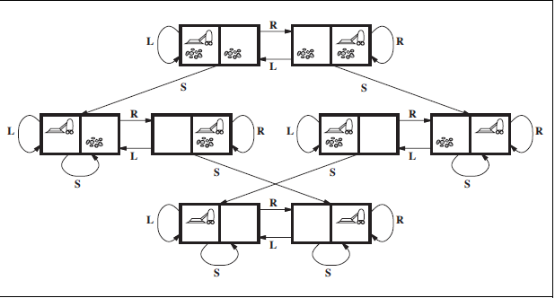
Solution

Slide 7
Examples
Vacuum cleaner problem
8 puzzle problem
8 queens problem
Route finding problem
2 | 8 | 3
1 | 6 | 4
7 | - | 5
1 | 2 | 3
8 | - | 4
7 | 6 | 5

Slide 8
2 | 8 | 3
1 | 6 | 4
7 | - | 5
2 | 8 | 3
1 | - | 4
7 | 6 | 5
2 | - | 3
1 | 8 | 4
7 | 6 | 5
- | 2 | 3
1 | 8 | 4
7 | 6 | 5
1 | 2 | 3
- | 8 | 4
7 | 6 | 5
1 | 2 | 3
8 | - | 4
7 | 6 | 5

Slide 9
How to evaluate an algorithm
Complete?
Optimal?
Time complexity
Space complexity

